Slide 1
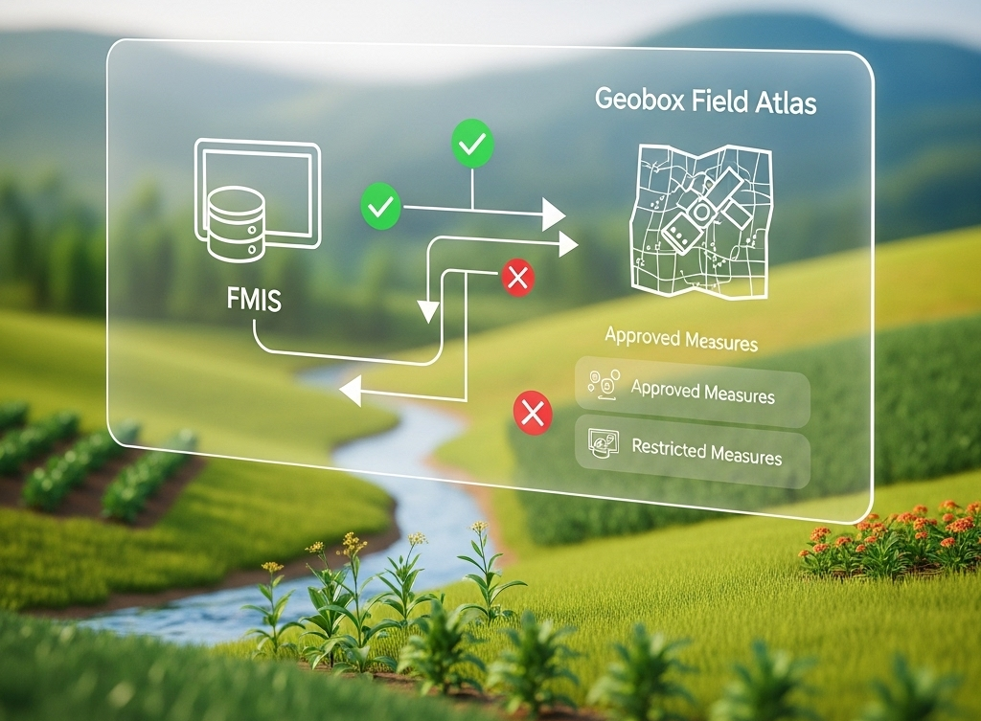
Cut office work by 50% with compliance checks by the push of a button
Team SafeAgri

Slide 2
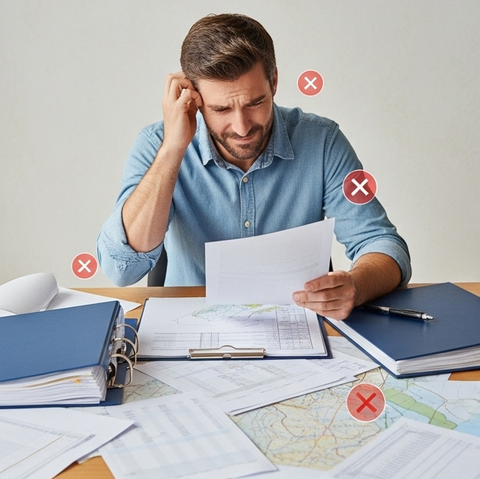
Background
Farmers must follow environmental laws that limit fertilization and pesticide use to protect water, soil, biodiversity, and food safety.

Slide 3

Problem Statement
Complex plant protection laws
Compliance checks are mostly manual and time consuming
Leads to uncertainty, higher costs, and risk of penalties
Lack of reports for audit

Slide 4
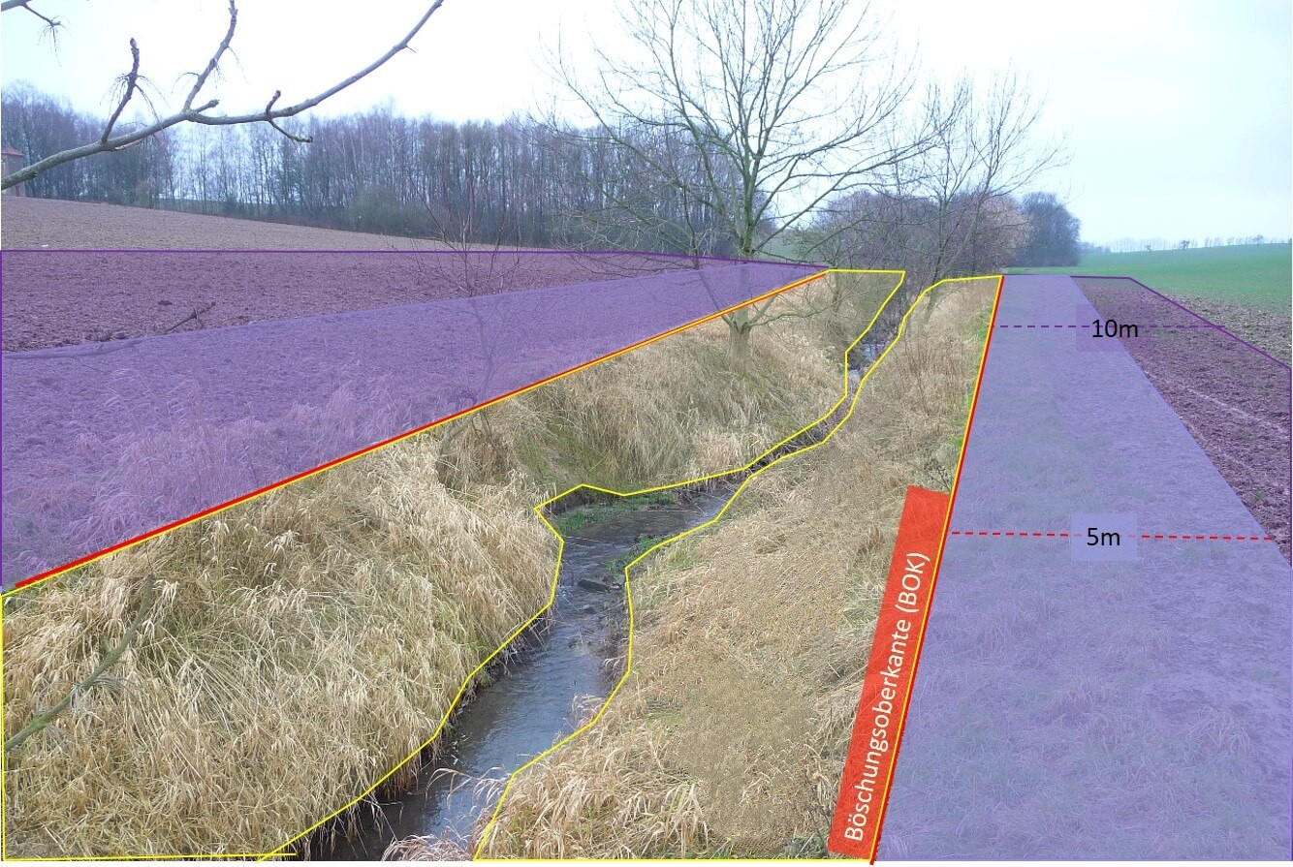
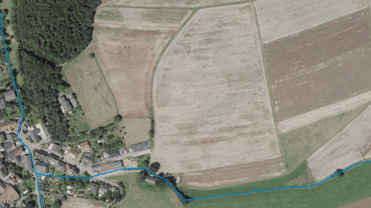
Problem Scenario

Slide 5
Present Challenges
API connection of FMIS and Geobox​
Scattered, inaccessible legal & compliance data​
Conversion of legal texts into an accessible machine-readable format

Slide 6
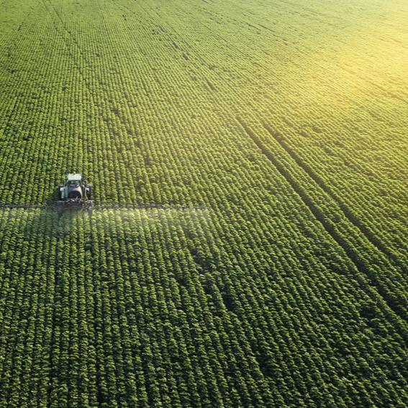
Goal
Farmers: Visualized, easy to understand compliance data​
Technical enabler: Ready to integrate, machine-readable data stream​
Stakeholders: human-readable documentation

Slide 7
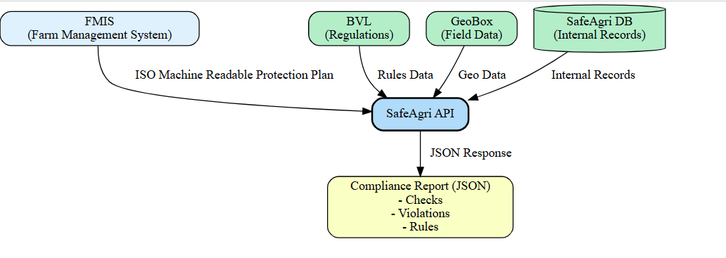
Proposed Solution

Slide 8

Proposed Solution & Impact
Our system turns complex regulations into an easy map that shows farmers exactly where spraying is allowed and where it is not.
Applies BVL rules (buffers, no-spray zones)
Calculates exact sprayable area
Alerts on boundary violations
Exports data for FMIS integration
Generates a standardized compliance report

Slide 9
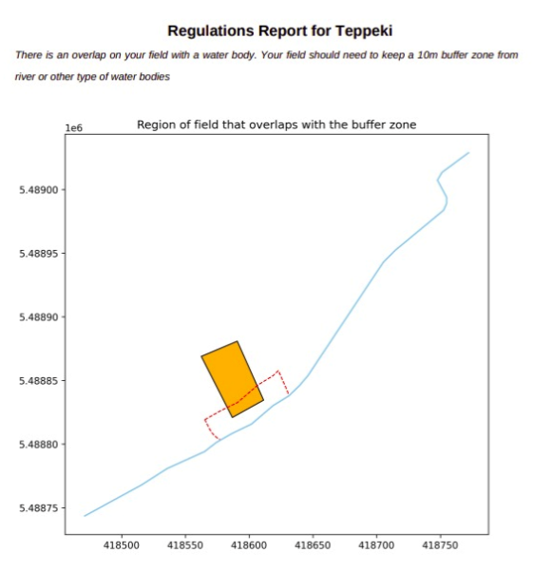
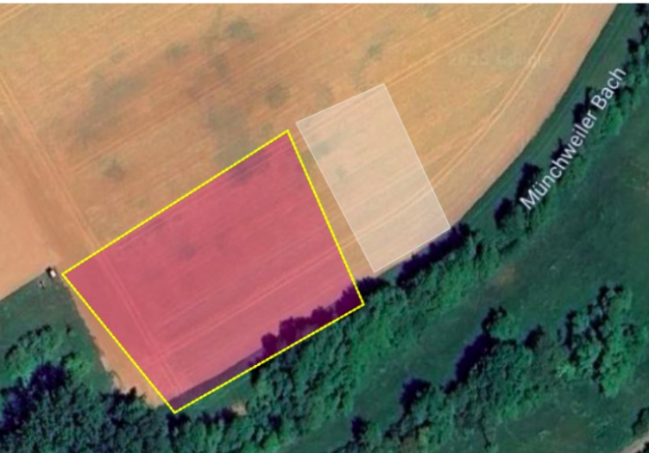
Regulation Check
Source: Plantivo

Slide 10


